Slide 1
Cognitive Literature Analysis
Team: Muggas Kuldeep Singh Sidhu & Aditya Rai

Slide 2
Project Objectives
Our main objective with this project is to provide enhanced analysis of speech, essays or any form of literature using the advancements in field of cognitive analysis.
01
Sentiment analysis on the subjects of the speech to check whether the speech for or against the subjects.
02
Analysing the speaker’s/writer’s personality on the basis of content of the literature.
03
To increase the functionality of this platform with more cognitive models for a complete analysis and feedback for the input on a one stop platform.

Slide 3
Technologies used
04
Data scraping
Web Application
Python (bs4, etc)
Python Web framework, HTML, JS, CSS
01
03
Data manipulation
Training models
Python, R
02
NLP, machine learning, cognitive analysis, etc

Slide 4
Project timeline (Work done in past 7 days)
11 FEB
12 FEB
13 FEB
14 FEB
15 FEB
16 FEB
17 FEB
Research
Data Collection
Data Manipulation & Transformation
Data Collection
Data Manipulation & Transformation
Research about the psychology and personality characteristics of a writer / speaker
Collection and labelling of data
Data manipulation and transformation & data modelling and algorithm testing
Creating web framework and platform to showcase the project
Completing the platform for end user release and testing

Slide 5
Project progress
We have completed the code
98 %
We are done with our model and testing.
The model needs to be deployed on a server for end user use

Slide 6
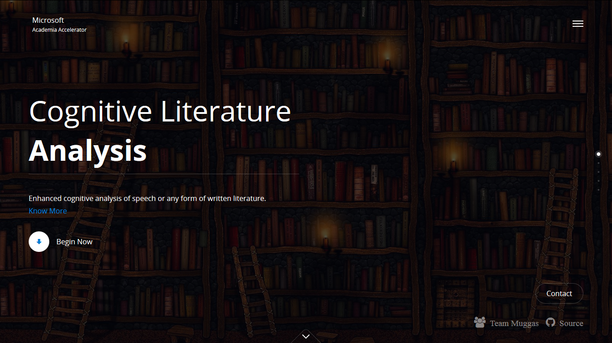
DEMO (Main landing screen)

Slide 7
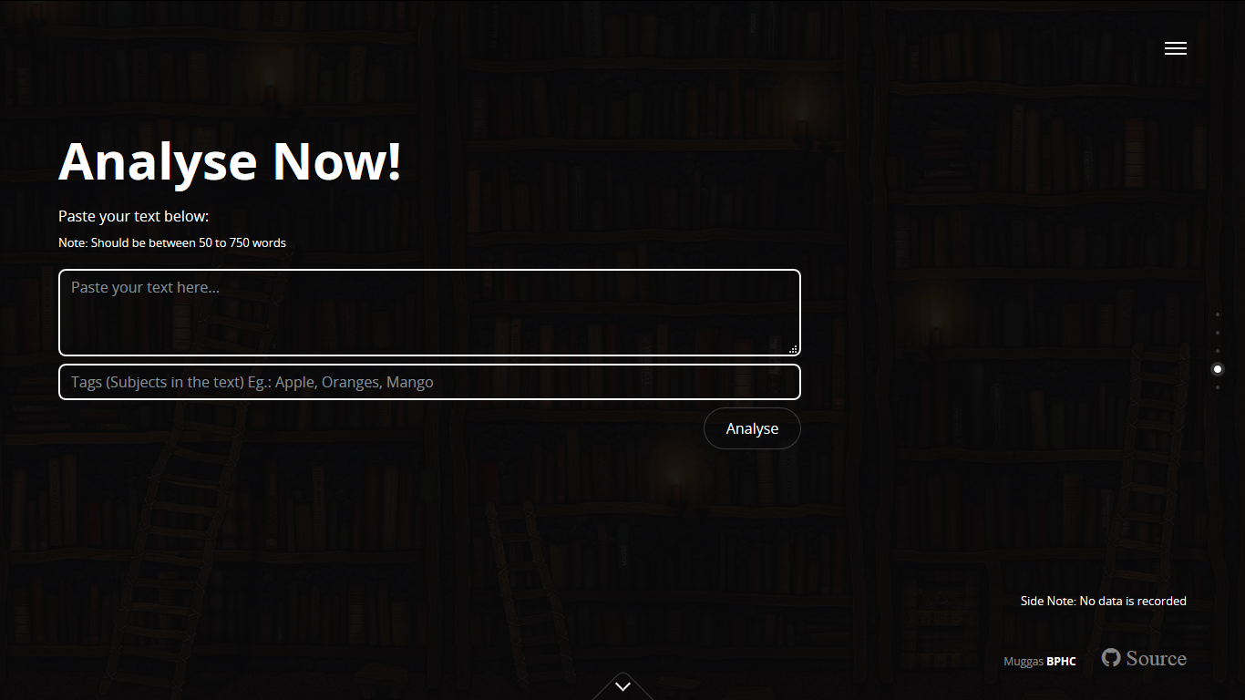
DEMO (Input page)

Slide 8
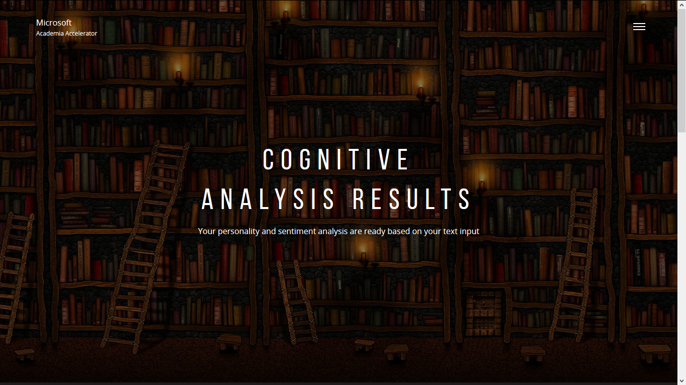
DEMO (Report landing screen)

Slide 9
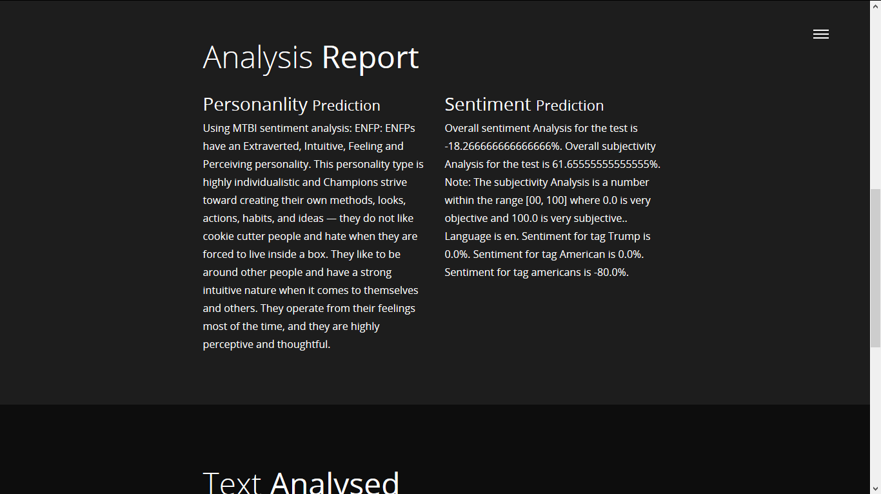
DEMO (Analysis page)

Slide 10
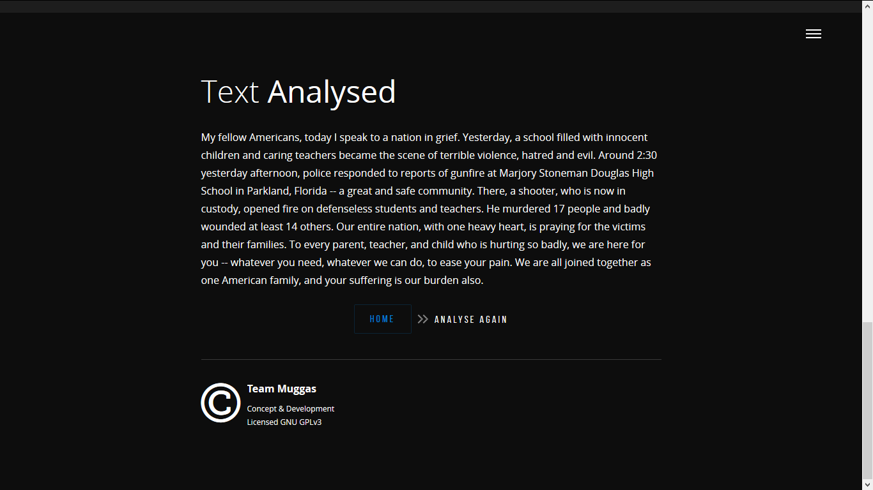
DEMO (Analysis page)

Slide 11
Code and all files, models
Link: https://drive.google.com/open?id=1VOeEaBT5fi43mAkZZwVhWxHd8IxjG2lS

Slide 12
Thank You
We would like to thank Microsoft and the team involved in giving such a good experience and learning opportunities.

